Slide 1
FDS, Kurtosion and Reliability Testing
Steve Smithson
Smithson & Assoc.,Inc
reps@smithson-associates.com

Slide 2
Abstract
The FDS is a spectrum representing cycle-counted cumulative damage with frequency resolution that applies to all shaker types.
The FDS is compatible with Miner’s rule for summing fatigue damage. GRMS methods may not be.
The FDS approach does not rely on the processing limitations of being Gaussian, or being stationarity and averaging of FFTs
Traditional PSD and g_{RMS} metrics are dependent upon models used and may not correlate well with shaker table results.

Slide 3
Rationale
Because excita­tions of greatly different peak probability distributions (PDFs) produce identical PSDs and g_{RMS} measurements, the FDS can be shown to better represent the actual severity of the excitation.
Substituting the cumulative Fatigue Damage Spectrum (FDS) and Damage Sum (Σ_{FDS} ) for PSD and g_{RMS} test profiles yields a test compression measure based on cumulative damage and leads to more relevant reliability estimate and confidence estimates as well as sample sizes.

Slide 4
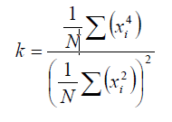
Don’t Miss the Damage
A major shortcoming, PSD-based random vibration tests are generated with Gaussian peak probability distributions which average out the extreme events.
The PPD should also described by kurtosis, the 4th statistical moment about the mean of a data set. Kurtosis describes the “peakiness” of the data and is described by the tails of the PPD and reflects a higher incidence of higher peak amplitudes than a Gaussian (normal) distribution.

Slide 5
Damage Sum Σ_{FDS}
Most Damage
Average Spectrum
SDoF via Smallwood RIRDF

Slide 6
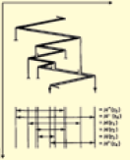
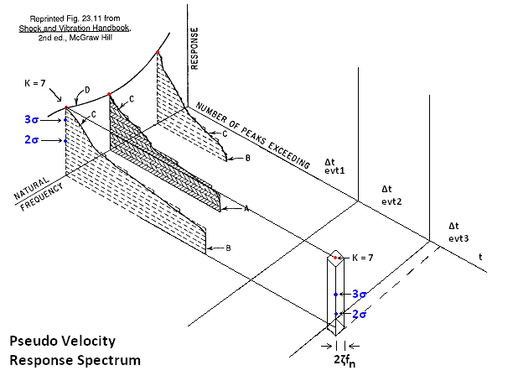
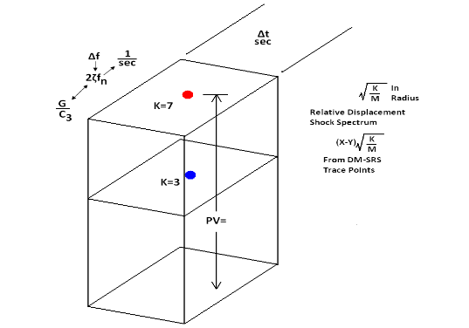
Response Spectrum
Substitutes Rainflow for SRS peak-hold
Rainflow Cycle Count SD0Fs at 1/24th octave

Slide 7
Scalar Σ_{FDS} is Volume Integral
FDS is of the form and includes the m & Q variables of Miner’s Rule
The Σ_{FDS} is a scalar quantity for comparison and compression for test acceleration
Applicable to resonance band analysis

Slide 8
Miner’s Rule Considertions
FDS variables -- m & Q generalized-- to be refined
Assembly level
Excitation – relevant field time histories, qual test
Response – characterize from field or sine sweep
Material – S-N slope at local target, test to failure

Slide 9
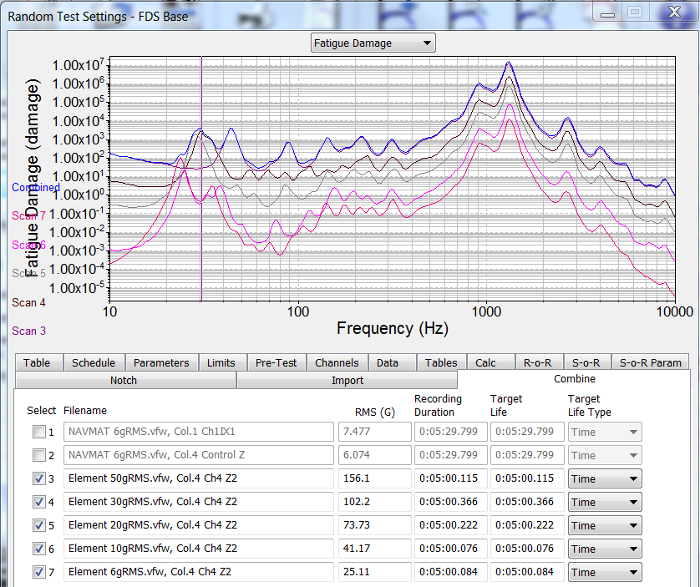
FDS of Multiple Time Histories
Represents:
Steps and cumulative Σ_{FDS} of HALT process-> Product strength
Regimes of Service Life & Warranty
Test track segments
Envelope (max) of different exposures
Cumulative damage of Qual & RDGT
Tests to failure

Slide 10
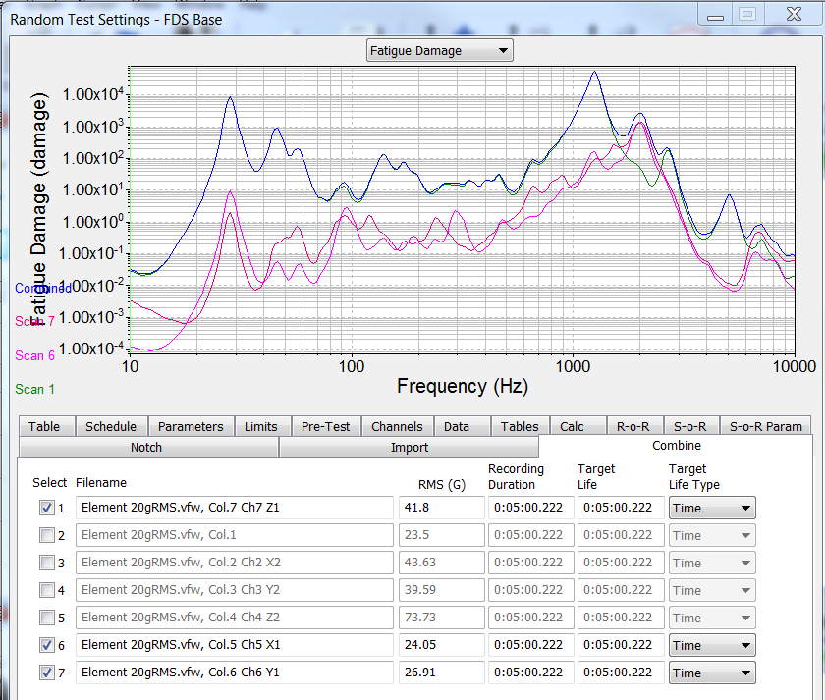
gRMS-- Σ_{FDS} Comparison
Two RS Machines
FDS plots for the horizontal plane (X and Y) and is Z axis (vertical) showing the X, Y, Z balance at a single accel location. RMS values between Z axis and X and Y axes vary by 1.6:1 whereas, in terms of damage in Table 2, they vary from 100:1 to 1000:1.

Slide 11
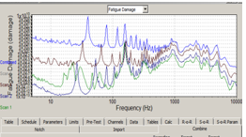
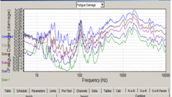
HALT & HASS on Different Machines?
Machines of different manufacture or different models from same manufacturer will usually show variability of damage from different table locations
FDS for same time exposure shows spectral and generates Σ_{FDS} for comparison with UUT resonant response bandwidths

Slide 12
Import or Run, get FDS & Σ_{FDS} Note kurtosis & Record Peaks
EUE– Service Life model with FDS & Σ_{FDS}
Qual test—Compare with EUE with FDS & Σ_{FDS}
HALT—Document Σ_{FDS} to failure & cumulative
HASS—as % of cumulative HALT Σ_{FDS}
RDT– FDS & Σ_{FDS} for test compression
Generate Gaussian PSD of Equivalent Damage
Re-introduce actual peaks via Kurtosion decreases test RMS

Slide 13
CONCLUSIONS
Look at the number of high excitation peaks in the excitation spectrum (Kurtosis) for a truer measure of damage.
FDS is a superior method to calculate damage models.
Check variability across the shaker table
FDS is a better way to describe HALT or HASS results, traditional tests and end-use environments

Slide 14
References
Smithson, Stephen A., “Correlating HALT & HASS, RS/HALT Vibration and End-Use Environments”, 2014 Accelerated Stress Testing & Reliability Workshop, St. Paul 10-12 October 2014
Van Baren, John G, and Achatz, Thomas, “Using Fatigue Damage Spectrum for Accelerated Testing with Correlation to End-use Environment”, 2014 Accelerated Stress Testing & Reliability Workshop, St. Paul 10-12 October 2014

